Slide 1
Medical Equipment Standards
What are standards?
Types of technical specifications covered in standards. Why are they important?
Examples of standards
17.4.1 Application of Standards to management and maintenance of medical equipment.
17.4.2 The purpose and importance of medical equipment standards.
Unit C 17.4 Global Medical Equipment Regulations
Module 279-17-C Regulations, Standards and Ethics
©
dr. Chris R. Mol, BME, NORTEC, 2015

Slide 2
Standard shoe sizes
In most countries we can order shoes (or clothes) simply by referring to a size.
This is only possible because manufacturers follow some industrial standards in making shoes and clothes.
There are no regulations covering shoe sizes !
International Standardization is more difficult to achieve……
Standards are not primarily about safety, but about convenience and efficiency ….
©
Standards in Management and Maintenance
dr. Chris R. Mol, BME, NORTEC, 2015

Slide 3
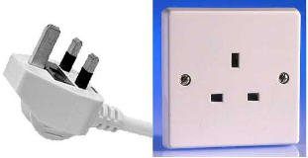
Non-standard electrical plugs
Incompatibility between electrical plugs and receptacles is a good example where different countries follow different standards.
For users/customers,
this hampers international travel
For manufacturers of products, this increases the cost of production, without adding value for customers.
©
Standards in Management and Maintenance
dr. Chris R. Mol, BME, NORTEC, 2015

Slide 4
Standardization
Name 10 things that are standardized across the world
Name 10 things that are not standardized, but that you would like to be standardized…..
©
Standards in Management and Maintenance
dr. Chris R. Mol, BME, NORTEC, 2015

Slide 5
Standardization
10 things that are standardized across the world
the internet / websites
e-mail
lightbulbs
USB sticks
car tire air connections
air traffic control
printer ink cartridges within one brand
phone call handling
SIM cards
paper sizes (A4, etc.)
freight container sizes
credit cards
Barcodes
10 things that are not standardized, but that users / travellers would probably like to be standardized…..
traffic: driving left of right side of the road
cars: steering wheel left or right in the car
traffic priority rules (on roundabouts)
electric power: voltage and frequency
financial currencies
sizes of shoes and clothes
printer ink cartridges between brands
…
©
Standards in Management and Maintenance
dr. Chris R. Mol, BME, NORTEC, 2015

Slide 6
Medical Equipment standardization is limited….
Standardized (examples only)
Medical gas / regulators, flow meters, ….
X-ray dose measurement
digital image data formats (DICOM)
Patient Information (HL7)
Not Standardized (examples only)
Consumables
Spare parts
User Interfaces
Performance (Image Quality, …)
….
Limiting competition ….
Equipment Inventory List Zambia(?), Form for Maintenance in Zambia(?), Preventive Maintenance protocols…
©
Standards in Management and Maintenance
dr. Chris R. Mol, BME, NORTEC, 2015

Slide 7
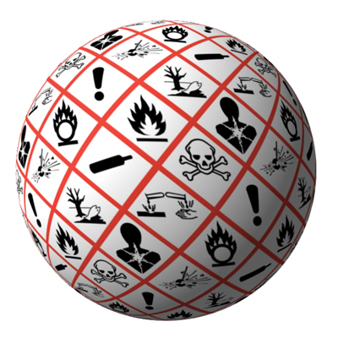
Standards in Medical Devices are important
Health care workers are well aware of incompatible consumables or replacement parts in medical devices of similar function that are made by different manufacturers (e.g. IV set, X-ray cassettes).
The lack of available consumables and repair parts is an important cause of medical equipment problems that are constantly encountered in developing countries.
Most medical devices are used globally. The safety, performance and consistent quality of medical devices is, therefore, an international public health interest. Thus, global harmonization of medical device standards (and regulations) is critical.
End of Intro …
©
Standards in Management and Maintenance
dr. Chris R. Mol, BME, NORTEC, 2015

Slide 8
What is a standard ?
Standards are documented agreements
containing technical specifications or other precise criteria
to be used consistently as rules, guidelines or definitions of characteristics,
to ensure that materials, products, process and services are fit for their purpose.
A manufacturer can declare to be compatible with a specific standard. This will inform his customers on many underlying specifications & will assure the customer that his product will function well…..
©
Standards in Management and Maintenance
dr. Chris R. Mol, BME, NORTEC, 2015

Slide 9
Types of technical specifications covered in standards
Standards can establish a wide range of specifications for products, processes and services
1. Prescriptive specifications obligate product characteristics, e.g. device dimensions, biomaterials, test or calibration procedures
2. Design specifications set out the specific design characteristics of a product, e.g. operating room facilities or medical gas systems.
3. Performance specifications ensure that a product meets a prescribed test, e.g. strength requirements, measurement accuracy, battery capacity, or maximum defibrillator energy.
4. Management specifications set out requirements for the processes and procedures companies put in place, e.g. quality systems for manufacturing or environmental management systems.
A standard may contain a combination of specifications.
©
Standards in Management and Maintenance
dr. Chris R. Mol, BME, NORTEC, 2015

Slide 10
Why are Standards important ?
Standards can serve different purposes. They can:
1. Provide reference criteria that a product, process or service must meet.
2. Provide information that enhances safety, reliability and performance of products, processes and services.
3. Assure consumers about reliability or other characteristics of goods or services provided in the marketplace.
4. Give consumers more choice by allowing one firm’s products to be substituted for, or combined with, those of another.
©
Standards in Management and Maintenance
dr. Chris R. Mol, BME, NORTEC, 2015

Slide 11
Generic Management Standards
Recent years have seen the development and application of what are known as “generic management system standards”, where “generic” means that the standards’ requirements can be applied to any organization, regardless of the product it makes or the service it delivers, and “management system” refers to what the organization does to manage its processes.
With management standards standardize the methods of management, rather than the products (outcomes) of the company. This is based on the relation that if you have high quality management (if you are ‘a quality organization’), you will also have high quality products.
Two of the most widely known series of generic management system standards are:
the ISO 9000 series for managing quality systems, and
the ISO 14000 series for environmental management systems.
More about ISO 9000 series
later in this course…..
©
Standards in Management and Maintenance
dr. Chris R. Mol, BME, NORTEC, 2015

Slide 12
Result oriented Standards
Next to generic Management standards, you will also find reference to terms such as:
outcome-oriented standards,
objectives standards,
result-oriented standards
all with roughly the same meaning/intention.
These terms indicate that the standards specify the objectives (ends) to be achieved
while leaving the methods (means) to the implementers.
In other words: standards on what you will achieve, not how you will achieve it…..
This can minimize possible constrictive effects of standards.
©
Standards in Management and Maintenance
dr. Chris R. Mol, BME, NORTEC, 2015

Slide 13
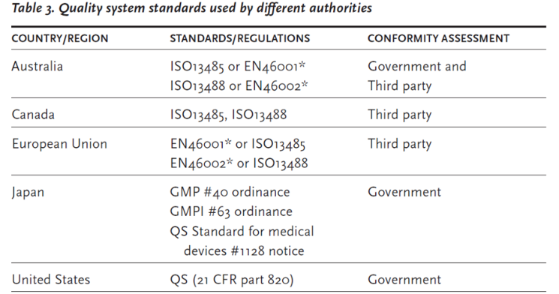
Examples of Standards
ISO13485 and ISO13488 are specific ISO quality systems standards for medical device manufacturing.
with international ‘harmonization’, differences can be reduced
©
Standards in Management and Maintenance
dr. Chris R. Mol, BME, NORTEC, 2015

Slide 14
Examples of Standards (continued)
ISO 13485:2003 is applicable to all providers and manufacturers of medical devices, components, contract services and distributors of medical devices. The standard is the basis for regulatory compliance in local markets, and most export markets.
ISO 9001:2008 signifies that a company engages in the creation of new products. It requires that the development of manufactured products have an approval process and a set of rigorous quality standards and development records before the product is distributed.
IEC 60601-1, for electrical medical devices, both mains-powered and battery powered. See separate lecture on this standard, later in this series of lectures)
IEC 62304 for medical software.
©
Standards in Management and Maintenance
dr. Chris R. Mol, BME, NORTEC, 2015
©

Slide 15
Conformity assessment with Standards
There are four common industrial methods for assessing conformity to a standard.
1. A product’s conformity to standards is commonly assessed by direct testing.
2. A process can be assessed by audit. Certification organizations or regulatory authorities attest that products or processes conform to a standard by authorizing the display of their certification mark.
3. The conformity to management standard by an organization is known as management systems registration. Formally established audit procedures are followed by certified auditors who are supported by technical experts of the domain under audit. Management System Registration bodies (Registrars) issue registration certificates to companies that meet a management standard such as ISO9000, or to medical device manufacturers that meet the ISO13485/ISO9001 standards.
4. Accreditation is used by an authoritative body to give formal recognition that an organization or a person is competent to carry out a specific task. For example, in Europe, Notified Bodies are notified or accredited by the relevant State Competent Authority to carry out conformity assessment of medical devices.
Note that in North America, the term “registration” is used for an organization while “certification” is reserved for products. Many other countries use “certification” for both a product and an organization.
©
Standards in Management and Maintenance
dr. Chris R. Mol, BME, NORTEC, 2015

Slide 16
National standards systems
A country may have many voluntary standards bodies. However, normally there is one official national organization that coordinates and accredits the standards development bodies in the country.
This official national organization would have the authority to endorse a document as a national standard in accordance with official criteria, and it also represents the country in the various international standards organizations.
In the United States, the American National Standards Institute (ANSI), a private, non-profit organization, is an official national organization.
In Europe there is a committee composed of CEN (Comité Européen de Normalisation), CENELEC (the European Committee for Electrotechnical Standard-ization) and ETSI (the European Telecommunication Standards Institute).
For developing countries, reference to a standards system not only helps medical device administration, it is also important for other industrial and economic developments. International development agencies increasingly realize that a standardized infrastructure is a basic requirement for the success of economic policies that will improve productivity, market competitiveness and export capability.
©
Standards in Management and Maintenance
dr. Chris R. Mol, BME, NORTEC, 2015

Slide 17
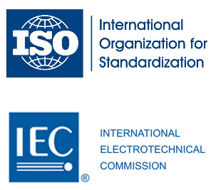
International standards systems
The three major international standardization organizations are:
the International Electro technical Commission (IEC), covering electrical and electronic engineering,
the International Telecommunication Union (ITU) for telecommunications
the International Organization for Standardization (ISO), covering the remainder.
For information technology, risk management, quality systems and many other areas, joint ISO/IEC technical committees manage standardization.
Other organizations also produce documents on international standardization. Their documents are usually adopted by ISO/IEC/ITU as international standards if they have been developed in accordance with international consensus criteria. Any grouping of five member countries can also propose a standard to be considered by ISO for adoption as an international standard.
©
Standards in Management and Maintenance
dr. Chris R. Mol, BME, NORTEC, 2015

Slide 18
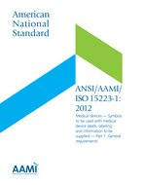
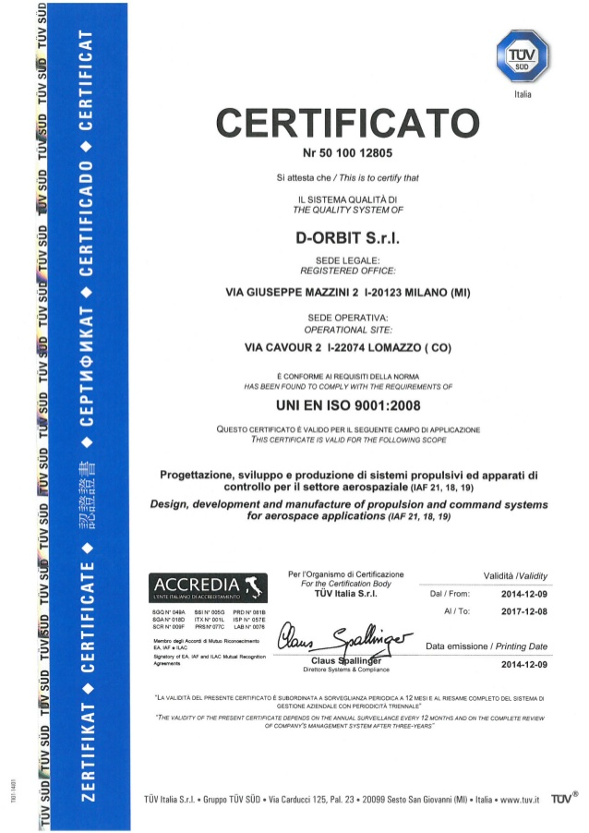
Identification of Standards
Standards are generally designated by an alphabetical prefix and a number. The letters (e.g. ISO, IEC) indicate the body that has approved them, while the numbers identify the specific standard and the year in which it was finalized.
The standard reference code often gives an indication of adoption where standards are equivalent. For example:
ANSI/AAMI/ISO 15223:2000 means the international standard ISO 15223 (established in 2000) adopted by the Association for the Advancement of Medical Instrumentations in the United States, which in turn is designated by the American National Standards Institute (ANSI) as an American national standard.
Accreditation
the standard
UNI EN ISO 9001 indicates an Italian national standard (UNI) which is an adoption of a European standard (EN), which is itself an adoption of the International Standard ISO9001.
©
Standards in Management and Maintenance
dr. Chris R. Mol, BME, NORTEC, 2015

Slide 19
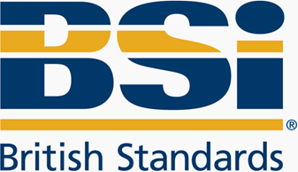
Names of Standards are indicated by prefixes
EN denotes a Standard which is adopted by the European community and is controlled by the European Committee for Standardisation (CEN).
ISO denotes a worldwide standard issued by the International Organisation for Standardisation.
National standards specify the requirements for application in the particular country.
BS denotes Britain's National Standards which are controlled by the British Standards Institute (BSI).
When a national standard is equal to the international standard, prefixes can be combined, as in e.g.
"BS EN ISO/IEC 17020: 2004 General criteria for the operation of various types of bodies performing inspection".
The ‘2004‘ in this name indicates the year that a version of the standard was agreed upon. It helps to distinguish
different versions of a standard that has evolved over time.
©
Electrical Safety Standards
dr. Chris R. Mol, BME, NORTEC, 2015

Slide 20
Voluntary standards rather than Regulations for medical devices
Although a standard can be set and mandated by an authority, the current trend is for the adoption of voluntary standards established by consensus from all interested parties.
The use of voluntary standards originated from the realization that while regulations generally address the essential safety and performance principles, manufacturers and users still need to know more, detailed specifications pertaining to specific products. This is better implemented by voluntary standards than by regulations.
The use of voluntary/consensus standards has many advantages including the following:
They are normally developed by experts with access to the vast resources available in the professional communities. By taking advantage of such existing resources, the government can overcome its own limited resources for providing product specific technical requirements and characteristics.
Conformity to standards can also be assessed by an accredited third party (such as a notified body in Europe), which is a well-established industrial practice around the world.
As technology advances, it is much easier to update standards than to change regulations. Timely development and periodic revision by expert groups make medical device standards effective and efficient tools for supporting health care.
©
Standards in Management and Maintenance
dr. Chris R. Mol, BME, NORTEC, 2015

Slide 21
END
The creation of this presentation was supported by a grant from THET:
see https://www.thet.org/

